Slide 1
Data Analysis for Myeong-dong malls

Slide 2
Background & Purpose
Background
-. Myeongdong is most famous place in Korea. Korea's financial hub is divided between here and Yeouido where the Korea Stock Exchange is located. Major insurance, securities, financial services companies, and investment firms with headquarters in Myeongdong.
-. Myeongdong is one of Seoul's main shopping districts featuring mid-to-high priced retail stores and international brand. It is a particularly popular area for young people and tourists as a center for fashion and sight-seeing.
-. Myeongdong Festival has been hosted since 1982 to vitalize the commercial area and encourage tourism.
2. Purpose
. Display 10 famous malls near the center of Myeong-dong.
. Display the location of the mall on the map of the Myeongdong area and indicate the distribution of the mall on the map.
-. Cluster the mall by using clustering method.
-. Classify Myeongdong area malls according to items and graph 10 items with high frequency of malls.

Slide 3
Description of the data
3. A description of the data and how it will be used to solve the problem
-. My daughter's favorite place is 'Myeong-dong' in Korea. There are many shops and entertainment place in there. I use Foursquare to identify the venues around the area of residence which are then shown in the Seoul map and execution.
-. In order to make a good explain about stores in 'Myeong-dong', the following data is required: Geodata (latitude and longitude) about Myeong-dong. List/Information about the stores information in Myeong-dong with geodata. I got a Geodata with Geolocator from Nominatim Pakage and then I download List/Information data about stores in Myeong-dong by connecting to Foursquare Web. with My client ID and Secret.
4. Interested Audience
. I believe this is a relevant project for a person or entity interesting K-POP and planning to visit Korea. The use of FourSquare data and mapping data combined with data analysis will help get the key information.

Slide 4
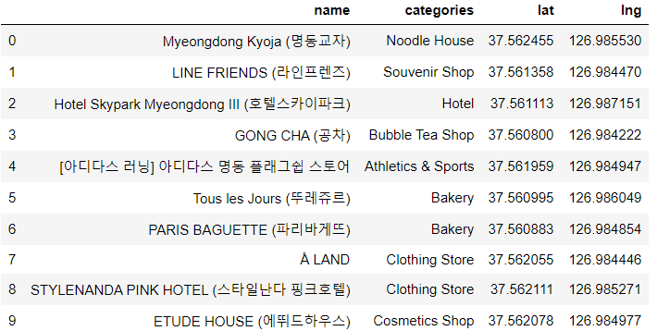
Data analysis Results
5. Data Analysis Results
-. information about 10 famous malls near the center of Myeong-dong

Slide 5
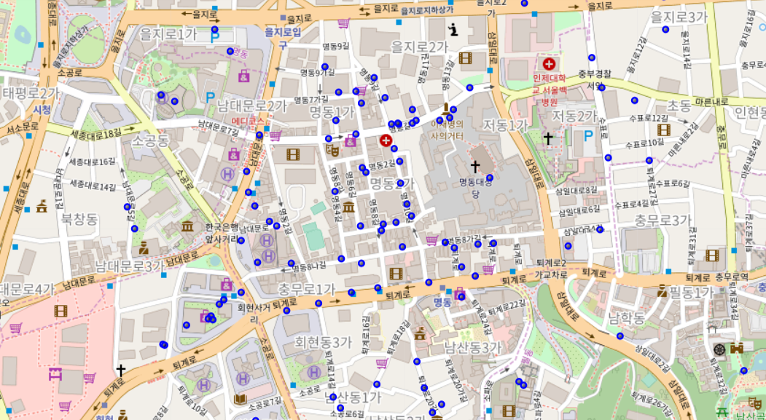
Data analysis Results
-. the location of the mall on the map of the Myeongdong area and indicate the distribution of the mall on the map

Slide 6
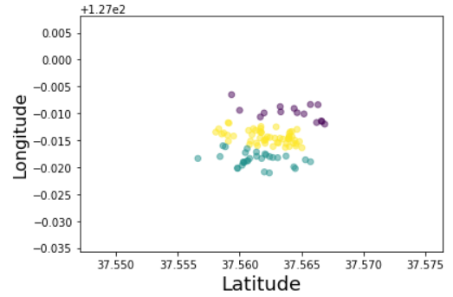
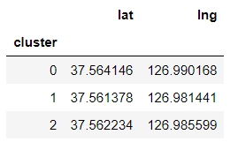
Data analysis Results
-. the clustering the mall by using clustering method

Slide 7
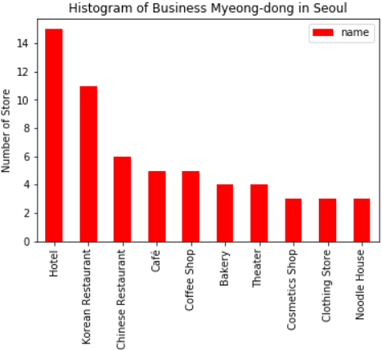
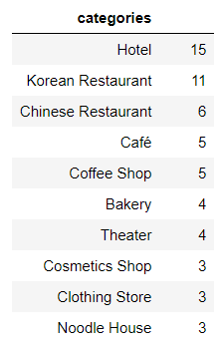
Data analysis Results
-. Classify malls in Myeongdong area and graph 10 items with high frequency of malls

Slide 8
Discussion & Conclusion
6. Discussion
-. I can start data project by myself from now on. I feel this Capstone project presented me a great opportunity to practice and apply the Data Science tools and methodologies learned.
-. I have a good starting point to become a professional Data Scientist and I will continue exploring to creating many examples in my working place.
7. Conclusion
-. I am doing a simple data analysis example about Myeong-dong Mall area. I think the information will help for visitor about Myeong-dong area. This project has shown me a practical application to resolve a real situation by using Data Science tools. The mapping with Folium is a very powerful technique to consolidate information and make the analysis and decision thoroughly and with confidence.
-. Furthermore, The analysis method will help to analyze more complicate data in real manufacruing process and make better analysis report.

